Slide 1

Heimdall: Mobile GPU Coordination Platform for Augmented Reality Applications
Juheon Yi, Youngki Lee
Seoul National University
ACM MobiCom 2020

Slide 2
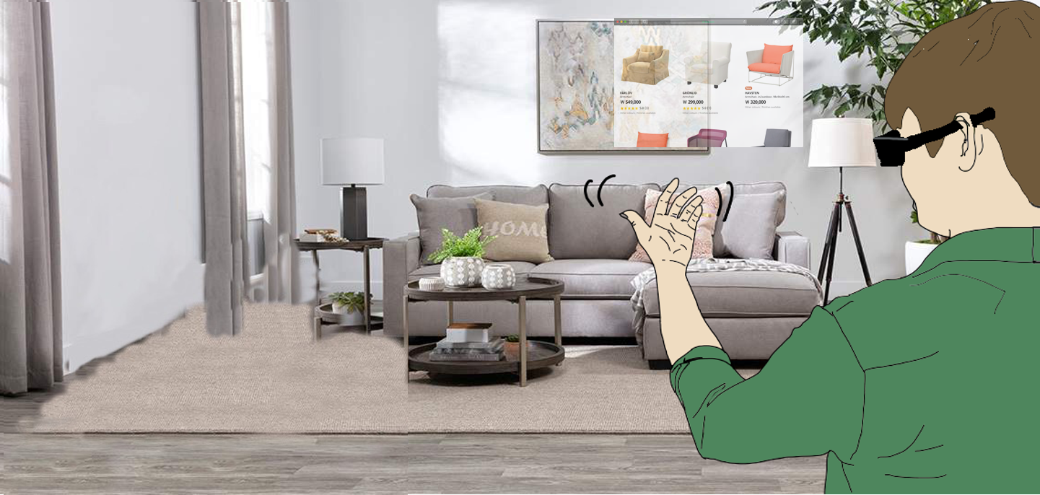
Example App: Immersive Shopping

Slide 3
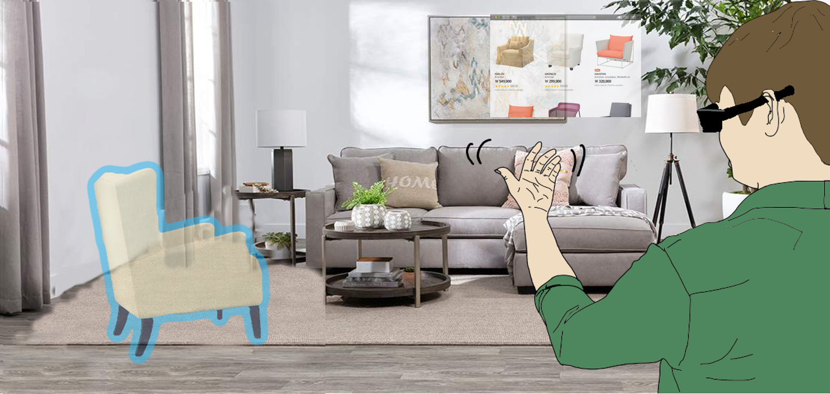
Example App: Immersive Shopping

Slide 4
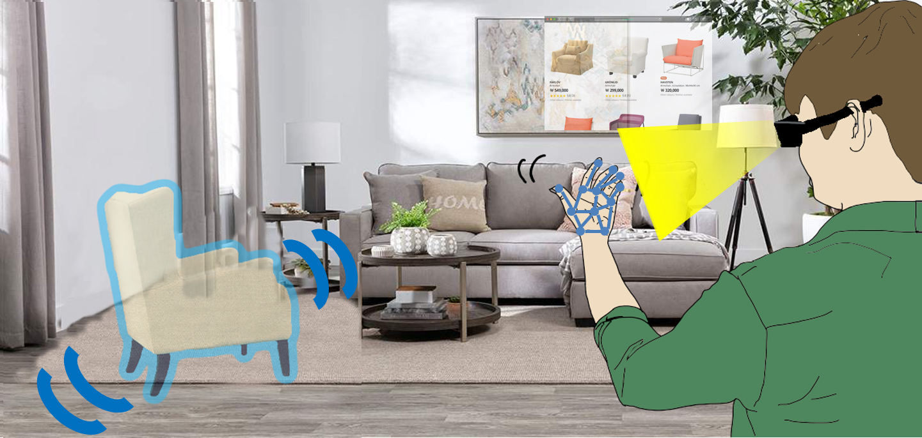
Example App: Immersive Shopping

Slide 5
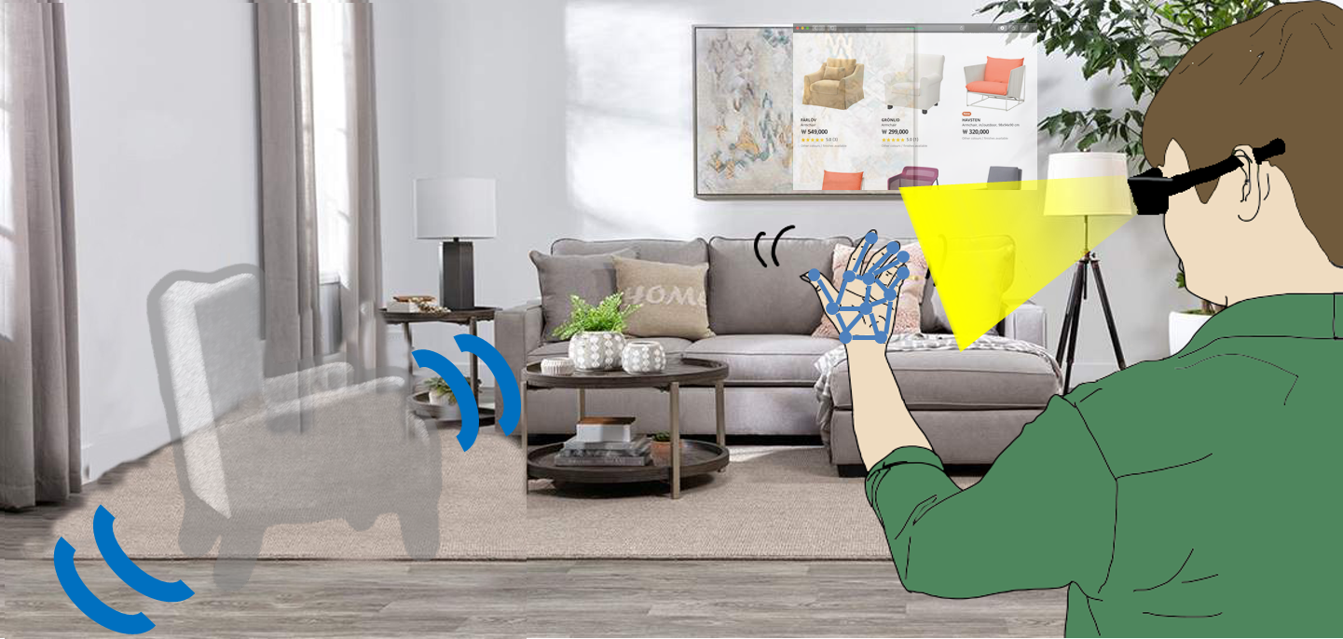
Example App: Immersive Shopping

Slide 6





Workload Analysis
DNN
Rendering
Device
Image Style Transfer
AR Glass
Concurrent execution of multi-DNN and rendering tasks on resource-constrained mobile GPU
Object Detection & Segmentation
Virtual couch
Hand tracking

Slide 7
Challenges
Existing frameworks are limited to single DNN execution
Multi-DNN GPU contention increases latency by up to 19x
Rendering-DNN GPU contention drops frame rate to as low as 12 fps
Why?
Mobile GPU schedulers are FIFO
Why not apply desktop GPU scheduling?
Parallelization: no architecture support
Preemption: challenging due to limited memory bandwidth

Slide 8
Proposed System: Heimdall
The first mobile GPU coordination platform for AR apps
Our approach: Pseudo-Preemption
When to trigger context switch?
Conventional preemption: regardless of the app context
Pseudo-Preemption: only when a semantic unit of a task is finished
→ large memory cost
→ no additional cost

Slide 9
Key: Dividing the Bulky DNNs
Task | Model | Inference time
Object detection | YOLO-v2 | 95 ms
Face detection | RetinaFace | 230 ms
Face recognition | ArcFace | 149 ms
Image segmentation | DeepLab-v3 | 207 ms
Image style transfer | StyleTransfer | 60 ms
Hand tracking | PoseNet | 256 ms
Text detection | EAST | 214 ms
DNN inference latencies are too long

Slide 10
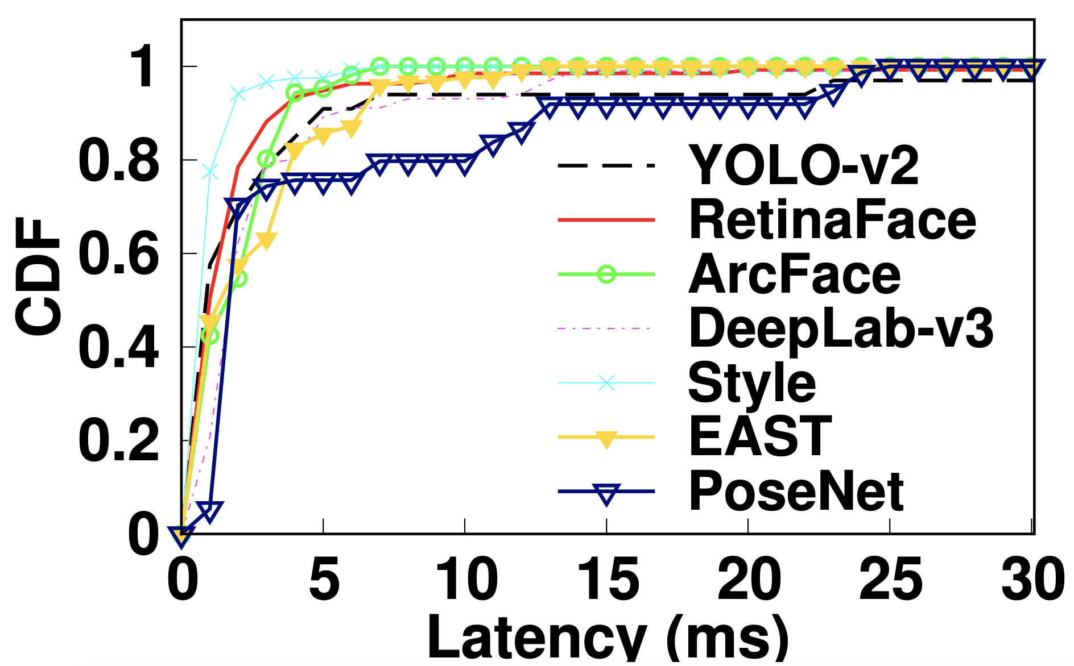
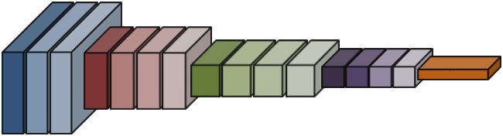
Key: Dividing the Bulky DNNs
Operator-level latency
DNN model
Conv1-1
Conv1-2
Pool1
Conv2-1
Conv2-2
Conv2-3
Pool2
Conv3-1
Conv3-2
Conv3-3
Conv3-4
Conv4-1
Conv4-2
Conv4-3
Conv4-4
FC1
DNNs can be divided into operators (89.8% runs in <5 ms)

Slide 11
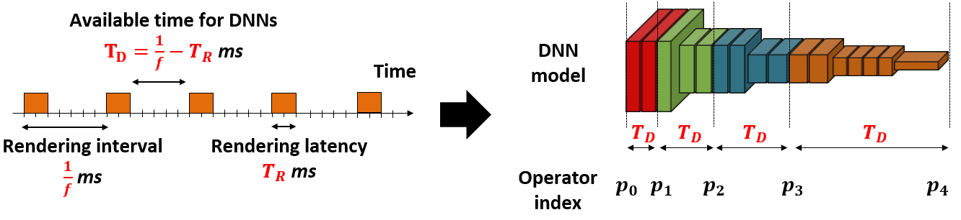
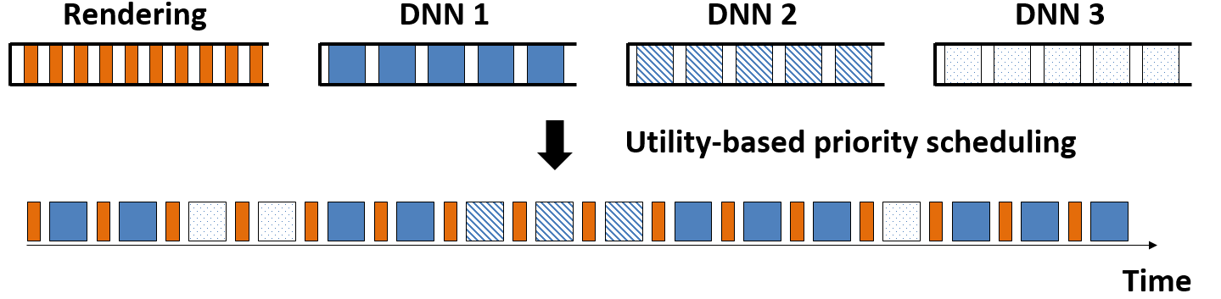
Heimdall System Overview
Preemption-Enabling DNN Analyzer breaks down the DNNs into smaller units
Pseudo-Preemptive GPU Coordinator schedules concurrent GPU tasks

Slide 12
Key Evaluation Results
Heimdall effectively coordinates the multi-DNN and rendering tasks
- Enhances the rendering frame rate from 12 to 30 fps
- Reduces the worse-case DNN inference latency by up to 15x
Heimdall flexibly supports various GPU coordination policies

Slide 13
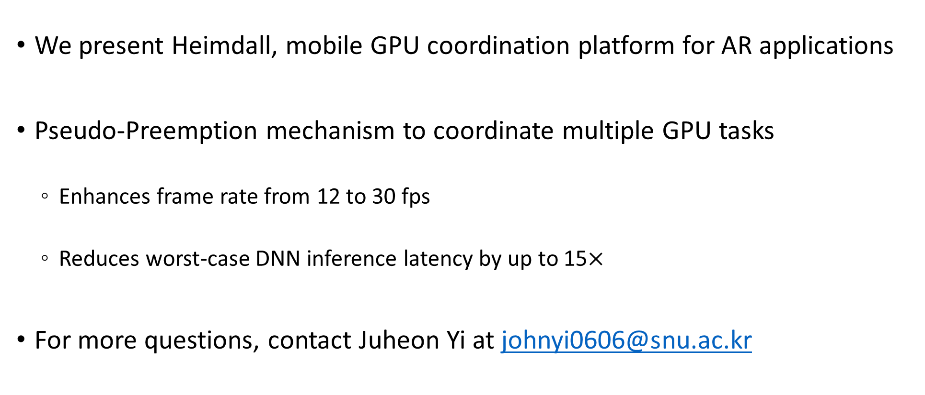
Summary
We present Heimdall, mobile GPU coordination platform for AR applications
Pseudo-Preemption mechanism to coordinate multiple GPU tasks
Enhances frame rate from 12 to 30 fps
Reduces worst-case DNN inference latency by up to 15$×$
For more questions, contact Juheon Yi at johnyi0606@snu.ac.kr
Juheon Yi and Youngki Lee, “Heimdall: Mobile GPU Coordination Platform for Augmented Reality Applications”

